Slide 1
Welcome to the CSE 180 Lab Section

Slide 2
Sql Scripts
Script files are text files of psql commands which can be executed like a batch file.
Person.txt
Person
-- create a table (annotation)
CREATE TABLE person (
Id int,
Name char(20),
Age int
);
id (integer) | Name (string) | Age (integer 1-200)
1 | binbin1 | 20
2 | binbin2 | 30

Slide 3
Sql Scripts
To run a sql script, use the syntax
\i filename
How to run a sql script on postgresql server?
If the postgresql commands have been stored in your local machine, then upload your sql script to your unix server machine by using command
scp xx CruzID@unix.ucsc.edu:xxxxx
Where xx is the path of file on your local machine, xxxxx is the path of the folder where you want to put the file on the unix server machine.

Slide 4
Sql Scripts
(2) If you want to create the file on the unix server machine directly.
First, log into the unix server.
Second, cd to the folder where you want to put the file
Third, use vim to edit your script by typing: vim filename
See this link for more information about how to use vim https://www.linux.com/training-tutorials/vim-101-beginners-guide-vim/

Slide 5
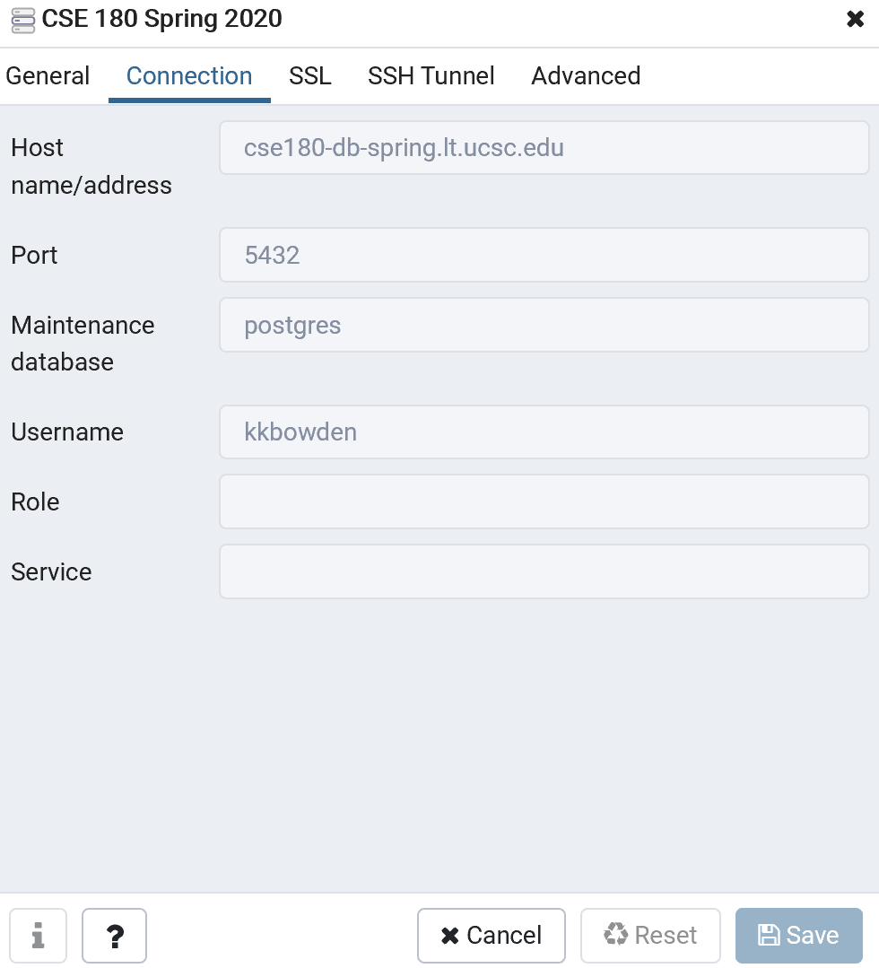
Sql Scripts
(3) Using pgAdmin
First, connect to the psql server:

Slide 6
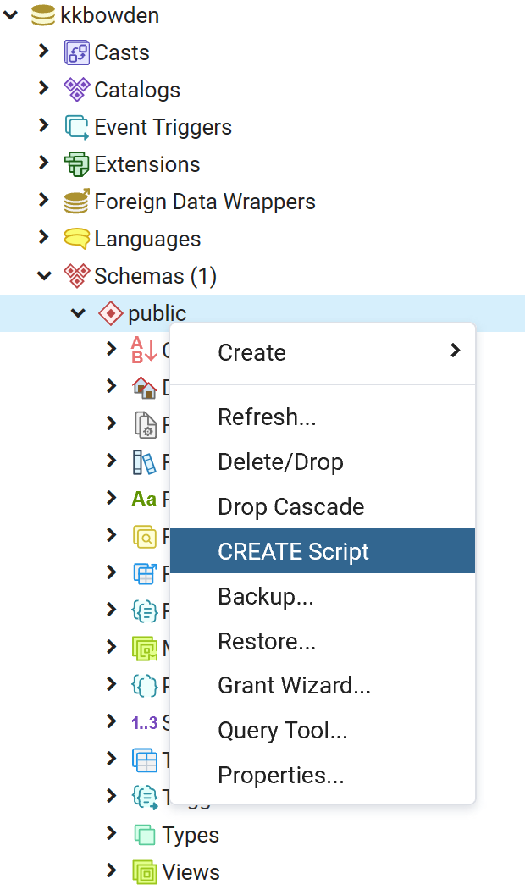
Sql Scripts
(3) Using pgAdmin
Second, right click on your username and create
the schema if it’s not already there.
Third, right click on public and click CREATE Script:

Slide 7
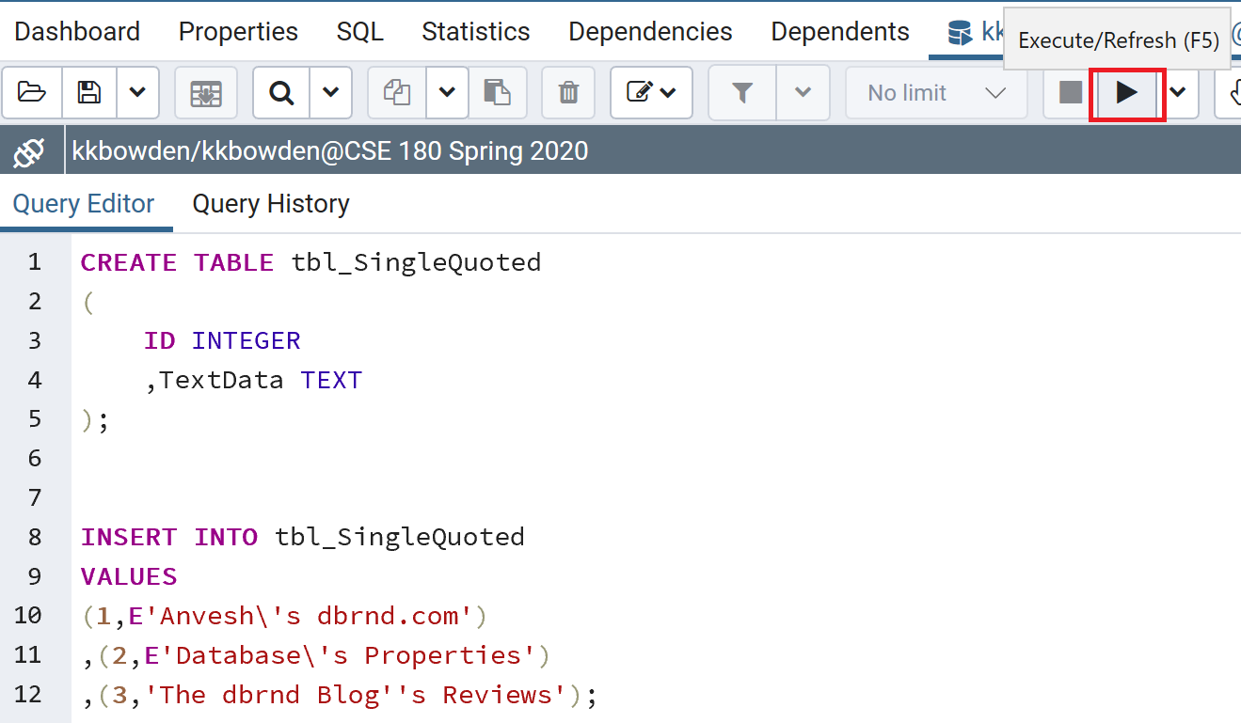
Sql Scripts
(3) Using pgAdmin
Now, write your code and
click run to execute your script:

Slide 8
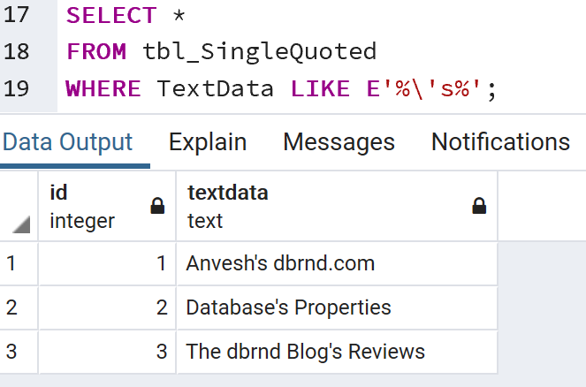
Sql Scripts
(3) Using pgAdmin
You can also write queries to
verify your data:

Slide 9
Sql Scripts
(3) Using pgAdmin
pgAdmin is a powerful GUI with many buttons to do a lot of the commands you need to write in your assignment, however, note:
You still need to turn in the commands used in a .txt file.
We strongly recommend using the script feature instead to actually learn the commands.

Slide 10
A Convenient Way to Load a Dataset
How to massively load datasets into your database on postgresql server?
Step 1: upload the dataset to unix server machine.
Step 2: using the following command to copy data to your database.
\copy xxx from 'xxxxx' delimiter ','
Where xxx is the table in which you want insert data, xxxxx is the path of the dataset, you can check the path of a file by typing pwd
Note: Although we provide a convenient way to load an existing dataset into your database here, you are strongly encouraged to master the INSERT INTO commands in this lab assignment.

